Slide 1
SIMPLE ELECTRONIC PIANO
CS-1 PROJECT BY:
21PWCSE2028 M. SADEEQ
21PWCSE2068 WASEEM SAJJAD
21PWCSE2040 MAAZ KHAN

Slide 2
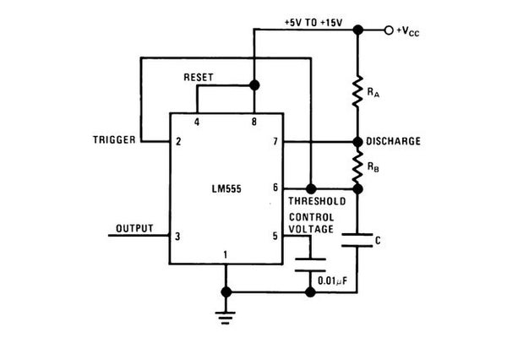
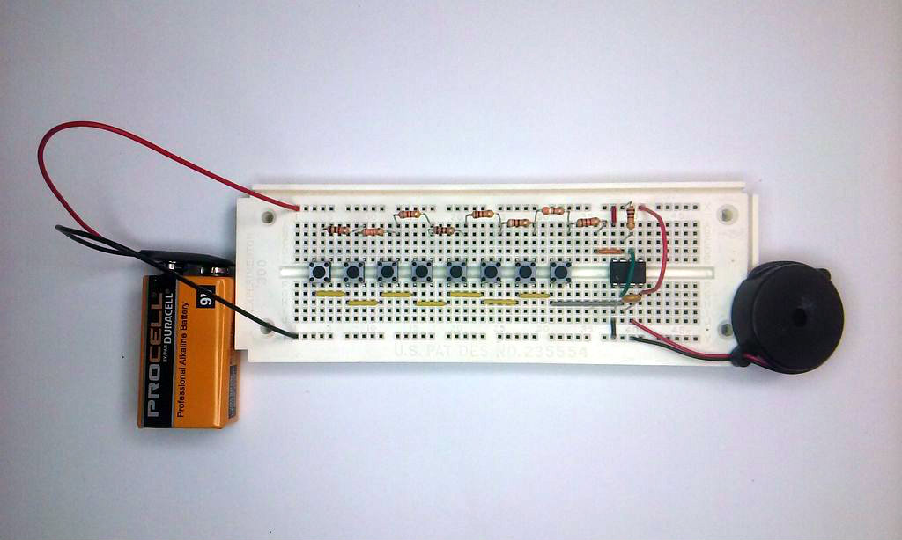
CIRCUIT DIAGRAM:-
USING BREADBOARD:-

Slide 3
COMPONENTS USED:-
1 x 555 timer
8 x pushbuttons
1 x 100 nF capacitor
1 x Resistor assortment - 390Ω, 620Ω, 910Ω, 2 x 1kΩ, 1.1kΩ, 1.3kΩ, 1.5kΩ, 6.2kΩ
1 x Piezo buzzer
22 AWG hookup wire
1 x 9V battery connector
1 x Solderless breadboard
1 x 9V battery

Slide 4
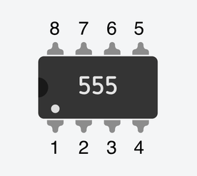
PROCEDURE:-
Start off by placing the 555 timer chip in the breadboard. The pins of the 555 are numbered 1, 2, 3, 4 on the bottom from left-to-right and 5, 6, 7, 8 on the top from right-to-left. They run counter-clockwise starting at the lower left.
Connect pin 2 to pin 6 of the 555 using an appropriate length of hookup wire.
Connect pin 1 to the ground row at the bottom.
Connect pins 4 and 8 to the +9 volts row at the top of the board.

Slide 5
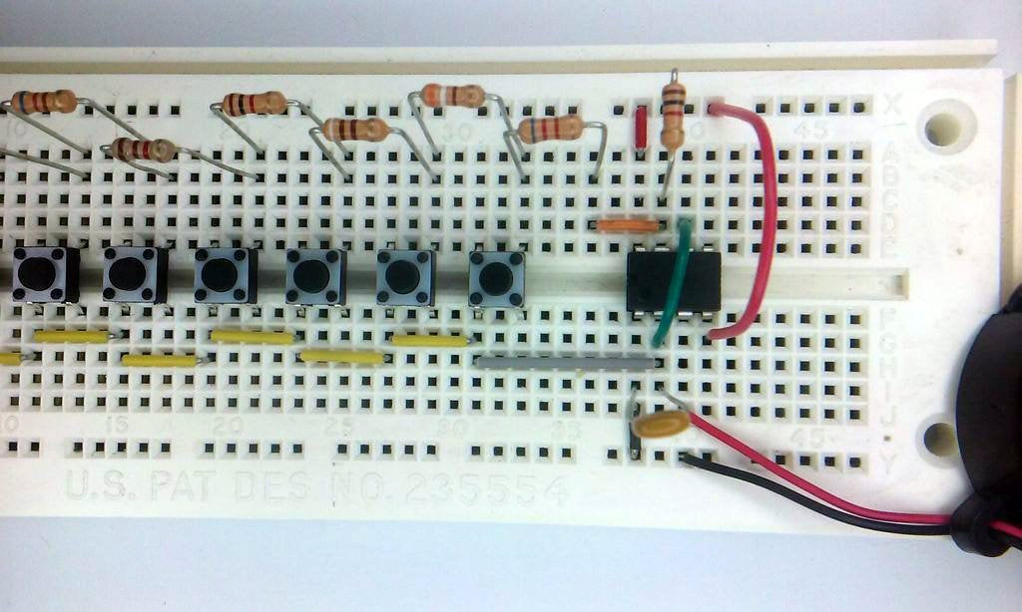
PROCEDURE:-
Carefully bend the leads of one of the 1kΩ resistors (brown-black-red) and connect it between pin 7 of the 555 and the +9 volt row at the top.
Connect the capacitor between pins 1 and 2 of the 555.
Place the buzzer over the breadboard to the right of the 555 with the negative pin on the ground row and put a hookup wire to connect positive pin with pin 3 of the 555.
Now, connect button and resistors from right to left.

Slide 6
WORKING PRINCIPLE:-
You can easily understand the working of above circuit if you know the working of Astable Multivibrator using 555. capacitor C (0.1μF) and all the resistors in the above circuit determines the frequency of oscillation of the multivibrator. Capacitor C’ (0.01μF) is connected to 5th pin to avoid high frequency noises and the capacitor C” (10μF) act as a coupling capacitor which will block dc and bypass ac signals to the loudspeaker. You can change the generated tones by varying the variable resistor Rb1 (10KΩ).
Note : You can operate 555 IC from 4.5 ~ 18V power supply, but it should not exceed the power rating of loudspeaker.

Slide 7


APPLICATIONS:-
Toys
Musical Instruments

Slide 8


